Slide 1
UNIT 13

Slide 2
Echolocation!!!
QOI: Is there a difference in the in-flight energy expenditures among all three animals after body size is accounted for? Explore the possibility of unequal slopes.
In order to answer this question, it will help first to test if all the regression lines are parallel (if the slopes are equal). If they are, then we can check for a difference in energy expenditure across all body sizes simultaneously. See Display 10.5 on page 276.
$$μ\left\{lenergy \right|lmass, TYPE\}= β_{0}{+β}_{1}lmass{+β}_{2}bird{+β}_{3}ebat{+β}_{4}lmass∗bird{+β}_{5} lmass ∗ebat$$
Indicator variables for the variable TYPE.
Which of the three types of animals (bird, ebat, or nebat) is the reference type in this model?
Nebat
It occurs when ebat = 0 and bird = 0.

Slide 3


Echolocation!!!
$$μ\left\{lenergy \right|lmass, TYPE\}= β_{0}{+β}_{1}lmass{+β}_{2}bird{+β}_{3}ebat{+β}_{4}lmass∗bird{+β}_{5} lmass ∗ebat$$
Individual regression equations for each value of TYPE:
Type = ebat occurs when ebat=1 and bird = 0.
0
0
$$μ\left\{lenergy \right|lmass, TYPE=ebat\}= β_{0}{+β}_{1}lmass{+β}_{2}∗0{+β}_{3}∗1{+β}_{4}lmass∗0{+β}_{5} lmass ∗1$$
$$μ\left\{lenergy \right|lmass, TYPE=ebat\}= β_{0}{+β}_{1}lmass{+β}_{3}{+β}_{5} lmass$$
$$μ\left\{lenergy \right|lmass, TYPE=ebat\}= β_{0}{+β}_{3}{+β}_{1}lmass{+β}_{5} lmass$$
$μ\left\{lenergy \right|lmass, TYPE=ebat\}=\left(β_{0}{+β}_{3}\right)+(β_{1}{+β}_{5})lmass$: slope = $β_{1}{+β}_{5}$
Type = bird occurs when ebat=0 and bird = 1.
0
0
$$μ\left\{lenergy \right|lmass, TYPE=bird\}= β_{0}{+β}_{1}lmass{+β}_{2}∗1{+β}_{3}∗0{+β}_{4}lmass∗1{+β}_{5} lmass ∗0$$
$$μ\left\{lenergy \right|lmass, TYPE=bird\}= β_{0}{+β}_{1}lmass{+β}_{2}{+β}_{4} lmass$$
$$μ\left\{lenergy \right|lmass, TYPE=bird\}= β_{0}{+β}_{2}{+β}_{1}lmass{+β}_{4} lmass$$
$μ\left\{lenergy \right|lmass, TYPE=bird\}=\left(β_{0}{+β}_{2}\right)+(β_{1}{+β}_{4})lmass$: slope = $β_{1}{+β}_{4}$
What is the regression equation for nebat (and slope)?
Type = nebat occurs when ebat=0 and bird = 0.
0
0
0
0
$$μ\left\{lenergy \right|lmass, TYPE=nebat\}=β_{0}{+β}_{1}lmass{+β}_{2}∗0{+β}_{3}∗0{+β}_{4}lmass∗0{+β}_{5} lmass ∗0$$
$μ\left\{lenergy \right|lmass, TYPE=nebat\}=β_{0}+β_{1}lmass$: slope = $β_{1}$

Slide 4
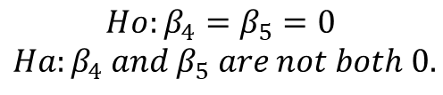
Echolocation!!!
$$μ\left\{lenergy \right|lmass, TYPE\}= β_{0}{+β}_{1}lmass{+β}_{2}bird{+β}_{3}ebat{+β}_{4}lmass∗bird{+β}_{5} lmass ∗ebat$$
Individual regression equations for each value of TYPE:
$μ\left\{lenergy \right|lmass, TYPE=ebat\}=\left(β_{0}{+β}_{3}\right)+(β_{1}{+β}_{5})lmass$: slope = $β_{1}{+β}_{5}$
$μ\left\{lenergy \right|lmass, TYPE=bird\}=\left(β_{0}{+β}_{2}\right)+(β_{1}{+β}_{4})lmass$: slope = $β_{1}{+β}_{4}$
$μ\left\{lenergy \right|lmass, TYPE=nebat\}=β_{0}+β_{1}lmass$: slope = $β_{1}$
All slopes are equal if $β_{1}{+β}_{5}=β_{1}=β_{1}{+β}_{4}, or β_{4}=β_{5}=0$.
$$Ho:β_{4}=β_{5}=0$$
$$Ha:β_{4} and β_{5} are not both 0.$$
We will do this with an Extra Sum of Squares Test.

Slide 5
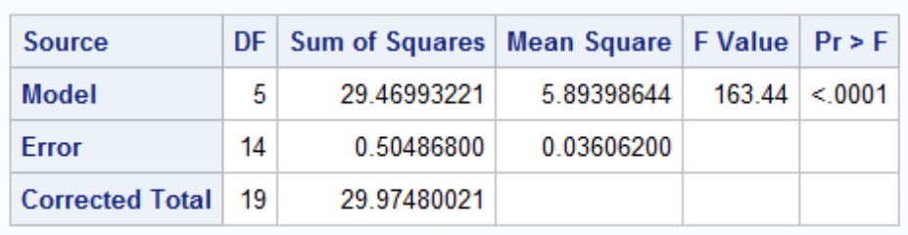
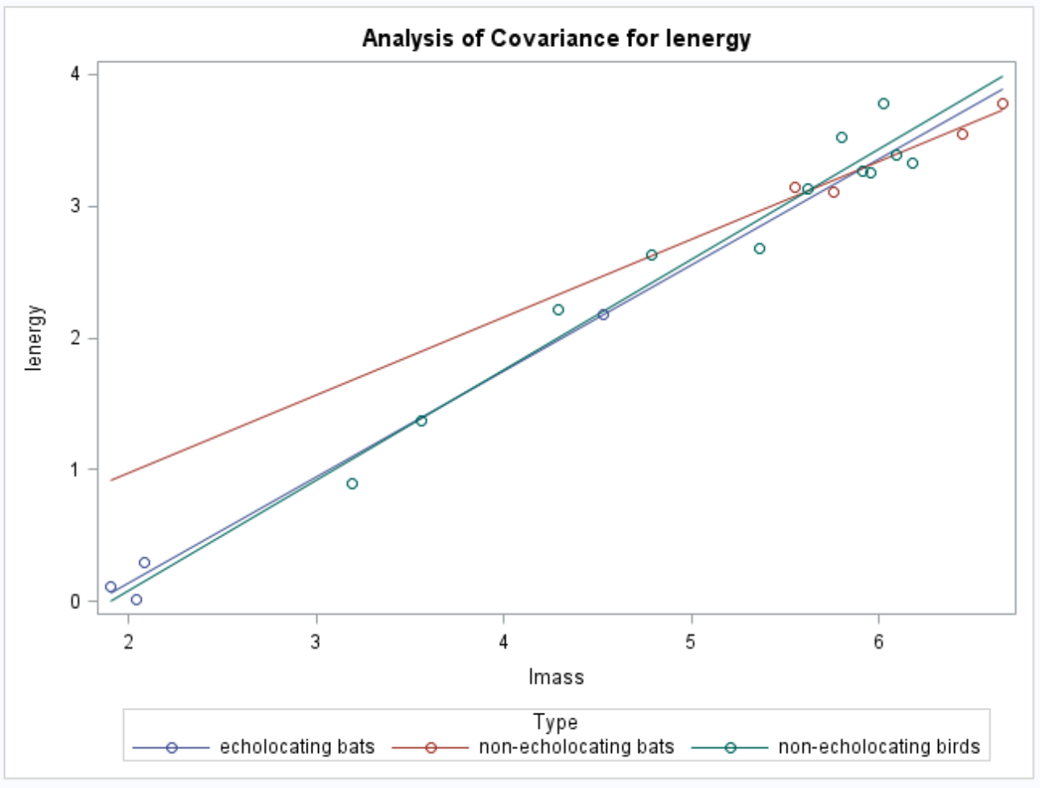
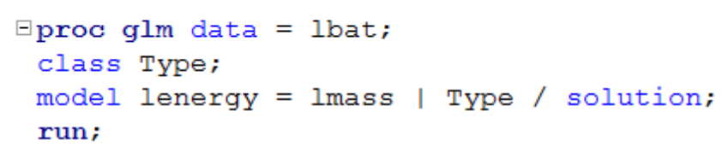
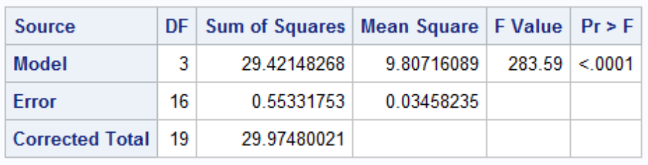
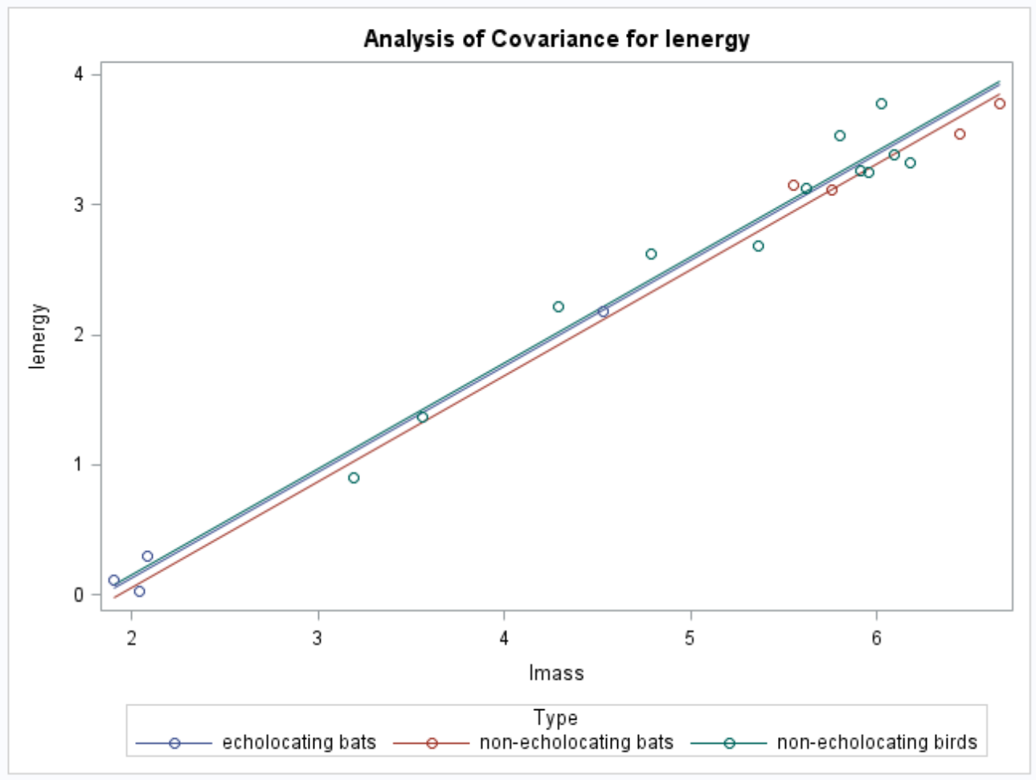
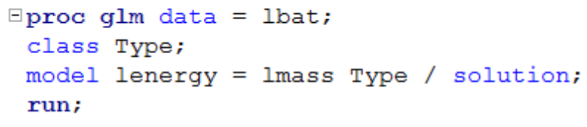
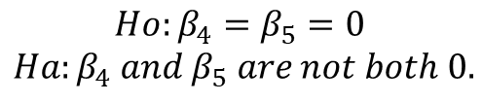
Echolocation!!!
QOI: Is there a difference in the in-flight energy expenditures among animals after body size is accounted for? (Is the model with the interaction between type and body size significantly different from the model without interaction?)
Plan of action: Lack of fit test (also called sum of squares test).
$$Ho:β_{4}=β_{5}=0$$
$$Ha:β_{4} and β_{5} are not both 0.$$
$$μ\left\{lenergy \right|lmass, TYPE\}= β_{0}{+β}_{1}lmass{+β}_{2}bird{+β}_{3}ebat+β_{4} lmass∗bird{+β}_{5} lmass ∗ebat$$
Full Model
$$μ\left\{lenergy \right|lmass, TYPE\}= β_{0}{+β}_{1}lmass{+β}_{2}bird{+β}_{3}ebat$$
Reduced Model

Slide 6
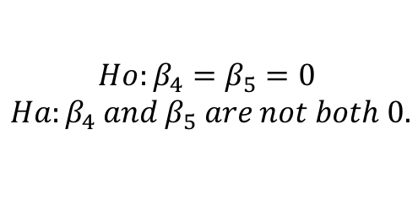
Echolocation!!!
QOI: Is there a difference in the in-flight energy expenditures among animals after body size is accounted for?
$$Ho:β_{4}=β_{5}=0$$
$$Ha:β_{4} and β_{5} are not both 0.$$
$$μ\left\{lenergy \right|lmass, TYPE\}= β_{0}{+β}_{1}lmass{+β}_{2}bird{+β}_{3}ebat+β_{4}lmass∗bird{+β}_{5} lmass ∗ebat$$
Full Model
Reduced Model
Source | Df | SS | MS | F | P-value
Model | 2 | .0485 | .02425 | .67867 | .5232
Error | 14 | .5048 | .0361
Total | 16 | .5533
Source | Df | SS | MS | F | P-value
Model
Error | 14 | .5048 | .0361
Total | 16 | .5533
Full Model
Reduced Model
Conclusion: There is not sufficient evidence to suggest that the lines are not parallel (p-value = .5232 from an Extra Sum of Squares F-test).

Slide 7
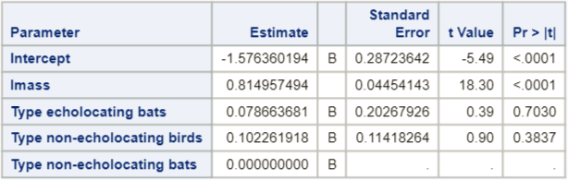
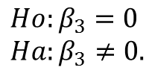
Echolocation!!!
QOI: Is there a difference in the in-flight energy of the TWO BAT types after body size is accounted for?
(Or, are the intercepts for the TWO BAT types different, after knowing that the slopes can be considered equal?)
$$μ\left\{lenergy \right|lmass, TYPE\}= β_{0}{+β}_{1}lmass{+β}_{2}bird{+β}_{3}ebat{+β}_{4}lmass∗bird{+β}_{5} lmass ∗ebat$$
Individual regression equations for each relevant value of TYPE:
$μ\left\{lenergy \right|lmass, TYPE=ebat\}=(β_{0}{+β}_{3})+β_{1}lmass$: intercept = $β_{0}{+β}_{3}$
$μ\left\{lenergy \right|lmass, TYPE=nebat\}= β_{0}+β_{1}lmass$ : intercept = $β_{0}$
Both intercepts are equal if $β_{0}{+β}_{3}=β_{0}, or β_{3}=0$.
$$Ho:β_{3}=0$$
$$Ha:β_{3}≠0.$$
Choosing one of the TYPES of interest to be the reference level makes this easy!
Data are consistent with the hypothesis of equal median in-flight energy expenditures between two bat types after accounting for the mass (size) (p-value = .7030).

Slide 8
Another Example: Try it!
Pred $SATScore= β_{0}+β_{1}GPA+ β_{2}Freshman+ β_{3}Sophomore$ $+ β_{4}Junior$
$+ β_{5}Freshman∗GPA$ $+ β_{6}Sophomore∗GPA$ $+ β_{7}Junior∗GPA$
Assume we have randomly sampled 35 students and the sum of squares residual (error) for the fit of the model above was 84.67. We also fit the model without the last three terms and found the sum of squares to be 130.7. Find an F-statistic and p-value to test if the slopes are the same for the 4 classifications (senior is the reference level) of high school students. In other words … perform an extra sum of squares test (also called lack of fit test).
Source | Df | SS | MS | F | P-value
Model
Error
Total
Full Model
Reduced Model

Slide 9
Example Sum of Squares Test
Source | Df | SS | MS | F | P-value
Model
Error |  | 84.67
Total |  | 130.7
Full Model:
Reduced Model:
*Bold entries are from info given directly on prior slide.
Full Model:
Pred $SATScore= β_{0}+β_{1}GPA+ β_{2}Freshman+ β_{3}Sophomore$ $+ β_{4}Junior$
$+ β_{5}Freshman∗GPA$ $+ β_{6}Sophomore∗GPA$ $+ β_{7}Junior∗GPA$
Reduced Model:
Pred $SATScore= β_{0}+β_{1}GPA+ β_{2}Freshman+ β_{3}Sophomore$ $+ β_{4}Junior$

Slide 10
Example Sum of Squares Test
Source | Df | SS | MS | F | P-value
Model
Error | 27 | 84.67
Total | 30 | 130.7
Full Model:
Reduced Model:
Full Model:
Pred $SATScore= β_{0}+β_{1}GPA+ β_{2}Freshman+ β_{3}Sophomore$ $+ β_{4}Junior$
$+ β_{5}Freshman∗GPA$ $+ β_{6}Sophomore∗GPA$ $+ β_{7}Junior∗GPA$
Reduced Model:
Pred $SATScore= β_{0}+β_{1}GPA+ β_{2}Freshman+ β_{3}Sophomore$ $+ β_{4}Junior$

Slide 11
Example Sum of Squares Test
Source | Df | SS | MS | F | P-value
Model | 3 | 46.03
Error | 27 | 84.67
Total | 30 | 130.7
Full Model:
Reduced Model:
Full Model:
Pred $SATScore= β_{0}+β_{1}GPA+ β_{2}Freshman+ β_{3}Sophomore$ $+ β_{4}Junior$
$+ β_{5}Freshman∗GPA$ $+ β_{6}Sophomore∗GPA$ $+ β_{7}Junior∗GPA$
Reduced Model:
Pred $SATScore= β_{0}+β_{1}GPA+ β_{2}Freshman+ β_{3}Sophomore$ $+ β_{4}Junior$

Slide 12
Example Sum of Squares Test
Source | Df | SS | MS | F | P-value
Model | 3 | 46.03 | 15.34
Error | 27 | 84.67 | 3.14
Total | 30 | 130.7
Full Model:
Reduced Model:
Full Model:
Pred $SATScore= β_{0}+β_{1}GPA+ β_{2}Freshman+ β_{3}Sophomore$ $+ β_{4}Junior$
$+ β_{5}Freshman∗GPA$ $+ β_{6}Sophomore∗GPA$ $+ β_{7}Junior∗GPA$
Reduced Model:
Pred $SATScore= β_{0}+β_{1}GPA+ β_{2}Freshman+ β_{3}Sophomore$ $+ β_{4}Junior$

Slide 13
Example Sum of Squares Test
Source | Df | SS | MS | F | P-value
Model | 3 | 46.03 | 15.34 | 4.89
Error | 27 | 84.67 | 3.14
Total | 30 | 130.7
Full Model:
Reduced Model:
Full Model:
Pred $SATScore= β_{0}+β_{1}GPA+ β_{2}Freshman+ β_{3}Sophomore$ $+ β_{4}Junior$
$+ β_{5}Freshman∗GPA$ $+ β_{6}Sophomore∗GPA$ $+ β_{7}Junior∗GPA$
Reduced Model:
Pred $SATScore= β_{0}+β_{1}GPA+ β_{2}Freshman+ β_{3}Sophomore$ $+ β_{4}Junior$

Slide 14
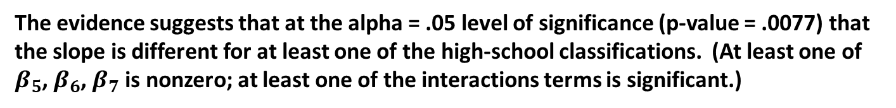
Example Sum of Squares Test
Source | Df | SS | MS | F | P-value
Model | 3 | 46.03 | 15.34 | 4.89 | .0077
Error | 27 | 84.67 | 3.14
Total | 30 | 130.7
Full Model:
Reduced Model:
The evidence suggests that at the alpha = .05 level of significance (p-value = .0077) that the slope is different for at least one of the high-school classifications. (At least one of $β_{5}$, $β_{6}$, $β_{7}$ is nonzero; at least one of the interactions terms is significant.)
Full Model:
Pred $SATScore= β_{0}+β_{1}GPA+ β_{2}Freshman+ β_{3}Sophomore$ $+ β_{4}Junior$
$+ β_{5}Freshman∗GPA$ $+ β_{6}Sophomore∗GPA$ $+ β_{7}Junior∗GPA$
Reduced Model:
Pred $SATScore= β_{0}+β_{1}GPA+ β_{2}Freshman+ β_{3}Sophomore$ $+ β_{4}Junior$

Slide 15
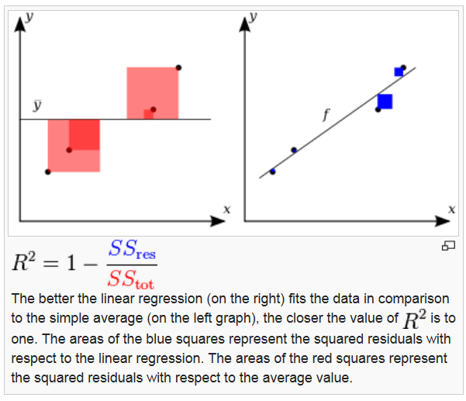

R²
$$R^{2}=\frac{{SS}_{tot}−{SS}_{res}}{{SS}_{tot}}$$

Slide 16
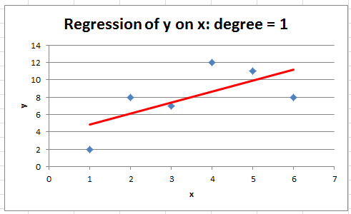
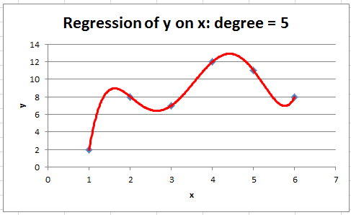
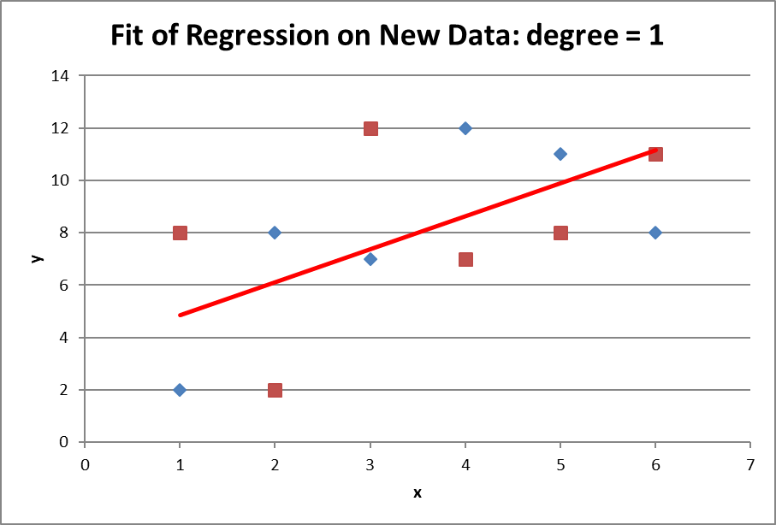
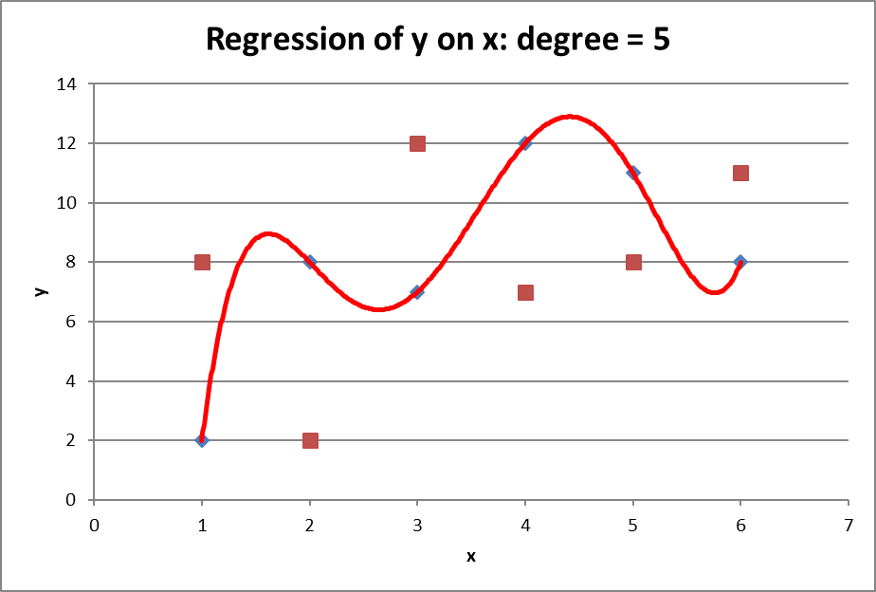

R² can always be made to be 100% by adding explanatory variables
R² is a statistic that indicates how well a model fits the sample data. It is not an indicator of how well the model will fit a new sample from the same population.
$$\hat{y}= β_{0}+β_{1}x$$
$$\hat{y}= β_{0}+β_{1}x+β_{2}x^{2}+β_{3}x^{3}+β_{4}x^{4}+β_{5}x^{5}$$
R² = .4461
R² = 1
SS_{res} = 0
SS_{res} = 34.3
SS_{res}=54.5
SS_{res}=140

Slide 17

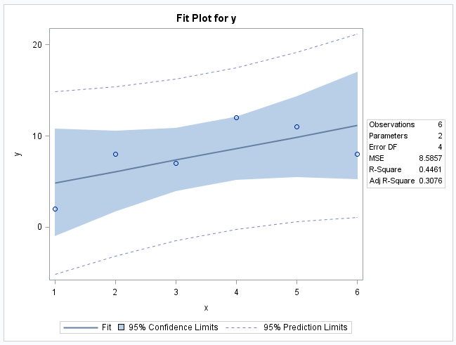



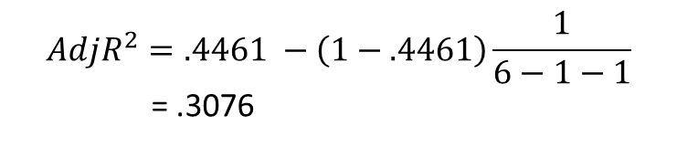
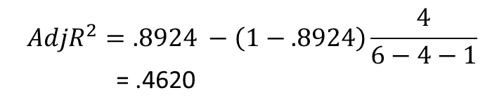

Adjusted R²
P = # predictor variables.
$$\hat{y}= β_{0}+β_{1}x$$
$$\hat{y}= β_{0}+β_{1}x+β_{2}x^{2}+β_{3}x^{3}+β_{4}x^{4}+β_{5}x^{5}$$
$$\hat{y}= β_{0}+β_{1}x+β_{2}x^{2}+β_{3}x^{3}+β_{4}x^{4}$$
$$AdjR^{2}=.4461 −\left(1−.4461\right)\frac{1}{6−1−1}$$
= .3076
$$AdjR^{2}=.8924 −\left(1−.8924\right)\frac{4}{6−4−1}$$
= .4620

Slide 18
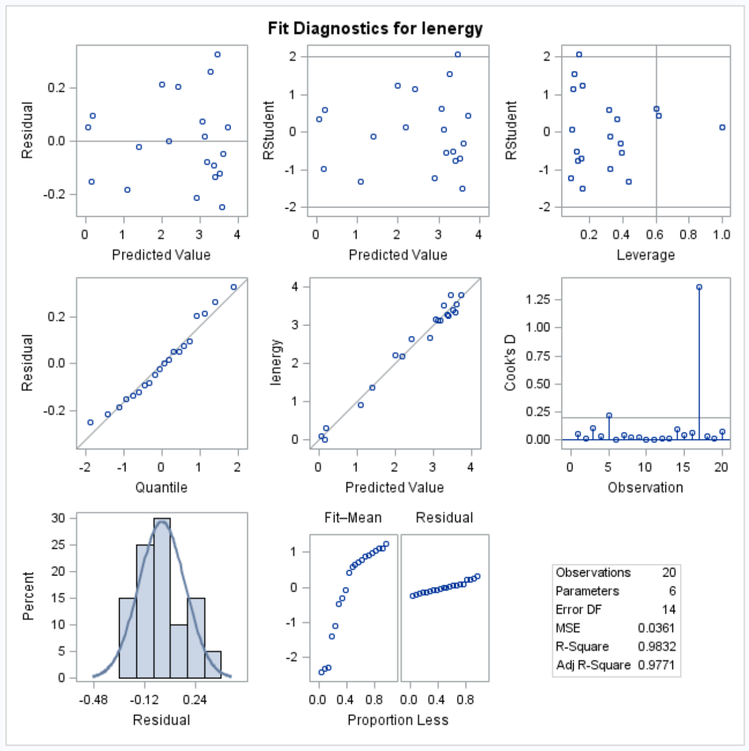
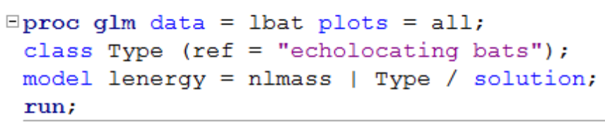
Where to find adjusted R² in proc GLM:

Slide 19
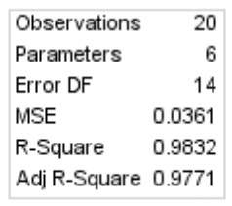
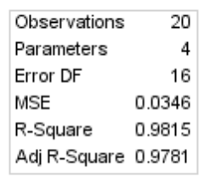
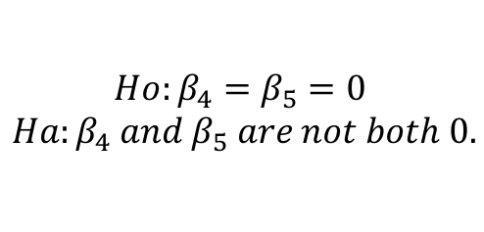
Back to Bat Echolocation Problem
$$Ho:β_{4}=β_{5}=0$$
$$Ha:β_{4} and β_{5} are not both 0.$$
$$μ\left\{lenergy \right|lmass, TYPE\}= β_{0}{+β}_{1}lmass{+β}_{2}bird{+β}_{3}ebat{+β}_{4}lmass∗bird{+β}_{5} lmass ∗ebat$$
Full Model
$$μ\left\{lenergy \right|lmass, TYPE\}= β_{0}{+β}_{1}lmass{+β}_{2}bird{+β}_{3}ebat$$
Reduced Model
The adjusted R² favors the model without the interaction parameters. Instead of an Extra Sums of Squares test, we could make the decision based on the adjusted R². A stronger analysis would show both the Extra SS test and the adjusted R².

Slide 20
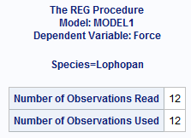

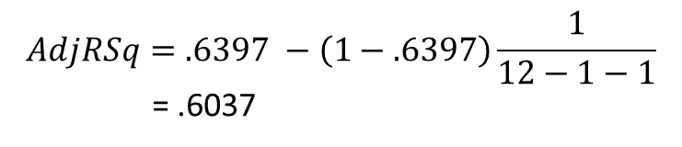

Practice Problem!
Calculate the Adjusted R² for the following model.
$$Pred Force= β_{0}+β_{1}Height$$
P = # predictor variables.
$$AdjRSq=.6397 −\left(1−.6397\right)\frac{1}{12−1−1}$$
= .6037

Slide 21
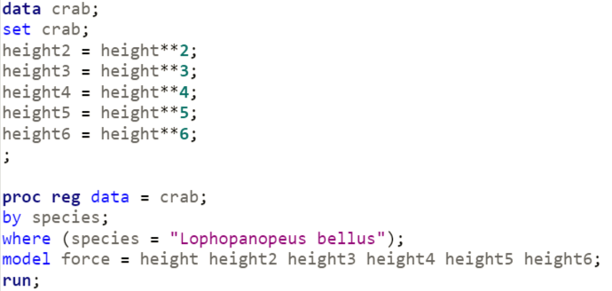


Practice Problem
SAS hint:
X² = x**2
X³ = X**3
Etc.
Data found in Crab17.
Use it to fit the following model for the Lophopanopeus bellus crabs only:
$Pred Force=β_{0}+β_{1}height+β_{2}{height}^{2}+β_{3}{height}^{3}$ $+β_{4}{height}^{4}$ $+β_{5}{height}^{5}$ $+β_{6}{height}^{6}$
Report the R² and the Adjusted R²

Slide 22
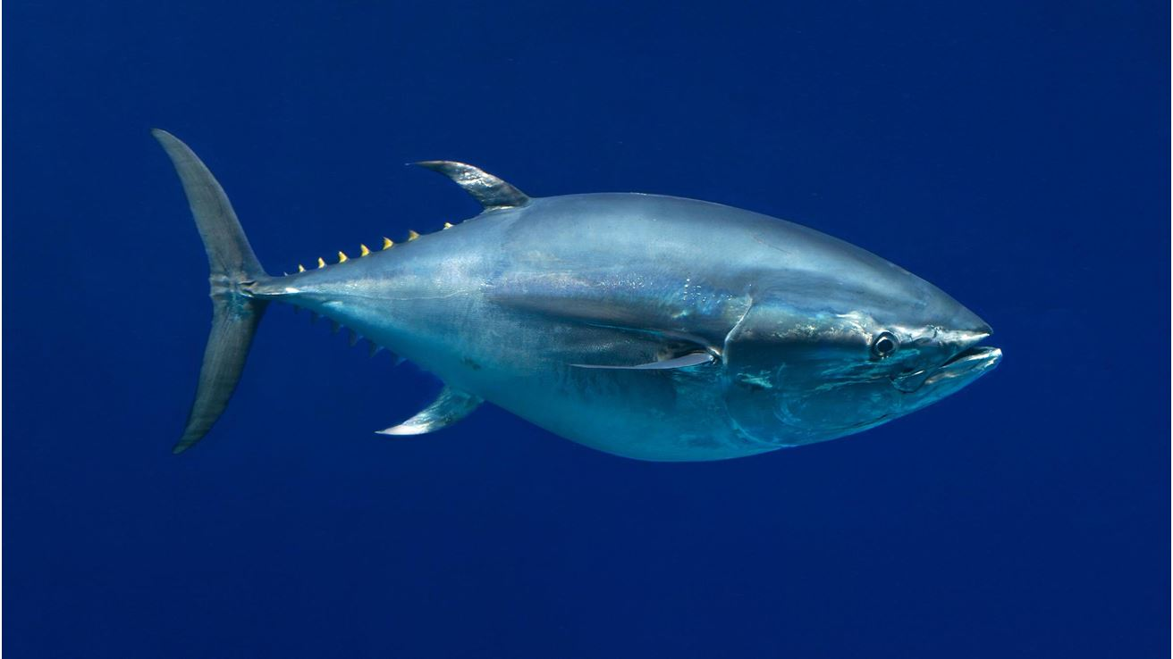

Slide 23
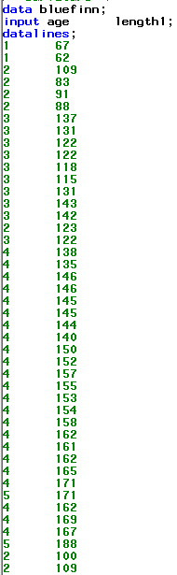
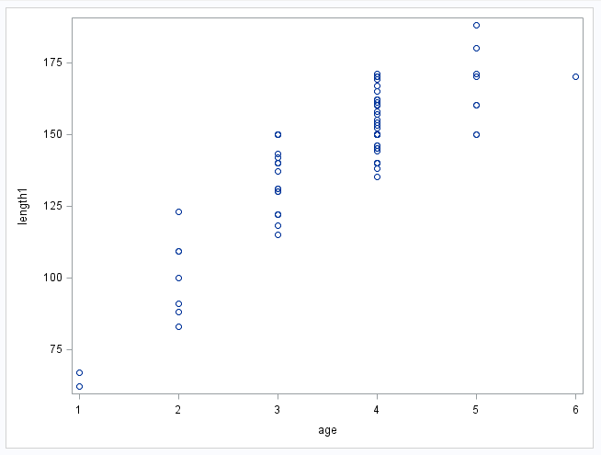
Quadratic Regression
Beautiful look at no evidence against normally distributed data per age.
Also great look at constant standard deviation per age.

Slide 24

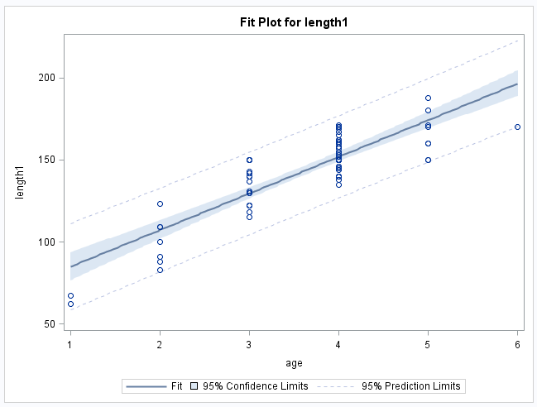
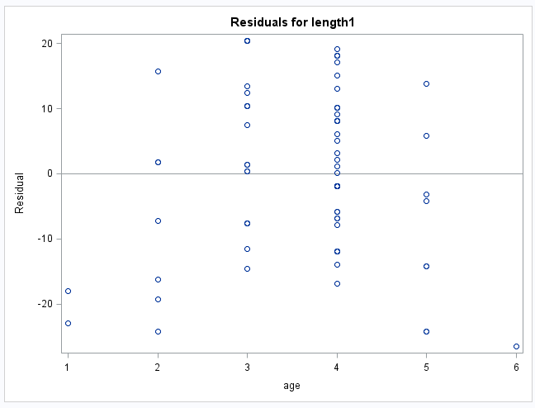

Simple Linear Fit
$$pred length= β_{0}+β_{1}age$$
The assumptions are not fully met (linear trend between age and the mean of length). There appears to be some evidence of a curved trend in both the scatter plot of the data and in the residuals. We can still use “linear” regression however ... We just need to transform age.

Slide 25
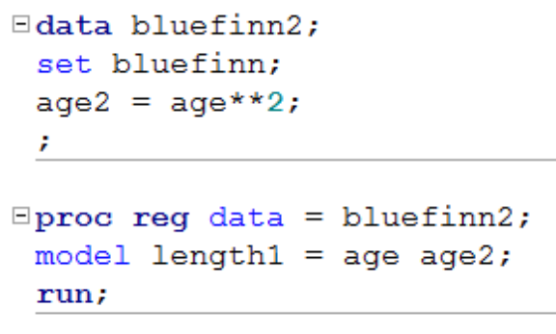
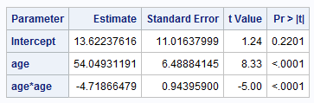
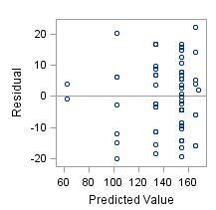
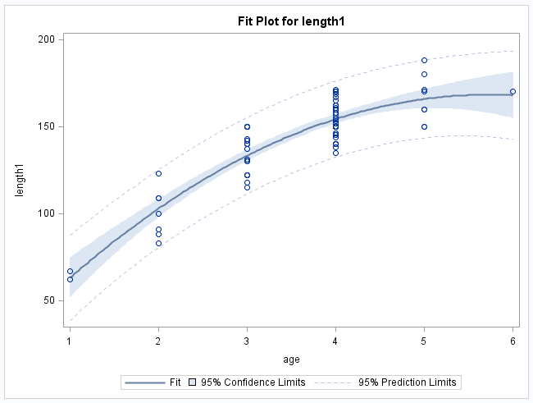

Quadratic Regression
Pred $length= β_{0}+β_{1}age+ β_{2}{age}^{2}$

Slide 26
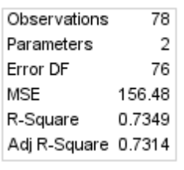
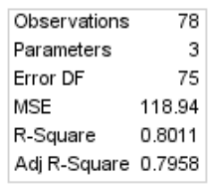


Comparing with adjusted R²
$$pred length= β_{0}+β_{1}age$$
Pred $length= β_{0}+β_{1}age+ β_{2}{age}^{2}$
The adjusted R² statistic favors the quadratic model despite the penalty for more predictors.

Slide 27
Quadratic Regression
$$pred length=13.6+54age−4.7{age}^{2}$$
Interpretation of coefficients is difficult... Quadratic terms are used mostly when the QOI is focused on prediction.

Slide 28
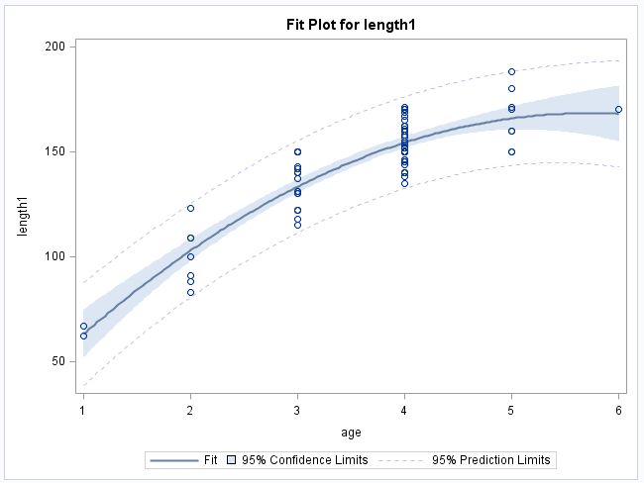
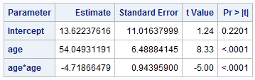

Quadratic Regression: Maximums
Can you find the estimated age at which the tuna’s tail is at its maximum?
$$\hat{length}= β_{0}+β_{1}age+β_{2}{age}^{2}$$
Parabola!!!

Slide 29
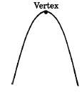

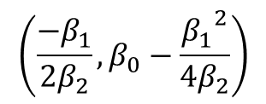
Dream Sequence …
Algebra II
$$\hat{length}= β_{0}+β_{1}age+β_{2}{age}^{2}$$
$$\left(\frac{−β_{1}}{2β_{2}},β_{0}−\frac{{β_{1}}^{2}}{4β_{2}}\right)$$

Slide 30

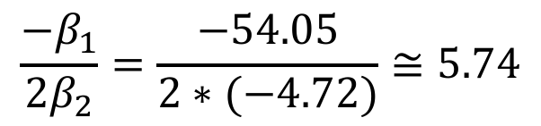
Quadratic Regression: Maximums
Can you find the estimated age at which the tuna’s tail is at its maximum?
$$\hat{length}= β_{0}+β_{1}age+β_{2}{age}^{2}$$
Parabola!!!
$$\frac{−β_{1}}{2β_{2}}=\frac{−54.05}{2∗(−4.72)}≅5.74$$
The evidence suggests that the mean age at which a Tuna’s tail stops growing is approximately 5.74 years based on a quadratic regression model (p-value < .0001).

Slide 31
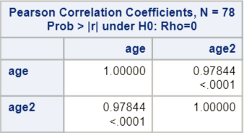
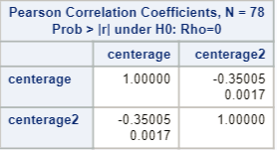

Example: Bluefin Tuna Re-centering method
$$pred length=β_{0}+β_{1}age+β_{2}{age}^{2}$$
Age and Age² are highly correlated (to be expected!), which is not good for two independent variables in the same regression model (for many reasons!).
Create a new variable, say centerage, that is age minus the mean of all the ages. Then, find centerage².
$$pred length=β_{0}+β_{1}centerage+β_{2}{centerage}^{2}$$
If you suspect some of the independent variables are dependent upon each other, centering (or standardizing) improves our ability to make inferences.

Slide 32
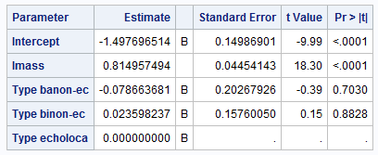

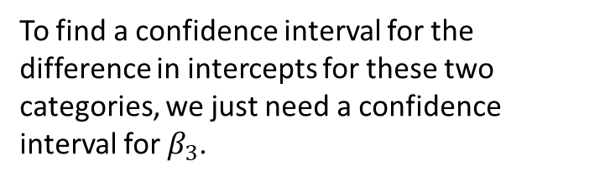
Energy Cost of Echolocation
Find a 95% confidence interval for the difference in the intercepts between non-echolocating birds and echolocating bats.
$$μ\left\{lenergy \right|lmass, TYPE\}= β_{0}{+β}_{1}lmass{+β}_{2}nebat{+β}_{3}bird$$
Ref = echolocating bat
Individual regression equations for each relevant value of TYPE:
$μ\left\{lenergy \right|lmass, TYPE=birds\}=(β_{0}+β_{3})+β_{1}lmass$: intercept =$β_{0}+β_{3}$
$μ\left\{lenergy \right|lmass, TYPE=ebat\}=β_{0}+β_{1}lmass$ : intercept = $β_{0}$
The difference in intercepts is $\left(β_{0}{+β}_{3}\right)−β_{0}=β_{3}$.
To find a confidence interval for the difference in intercepts for these two categories, we just need a confidence interval for $β_{3}$.
df = 16 (n=20)
MOE = t_{16,.975}*SE
MOE = 2.12* .1576
MOE = .3341
95% CI: (.0236 ± .3341)
95% CI: (-.3105, .3577)

Slide 33


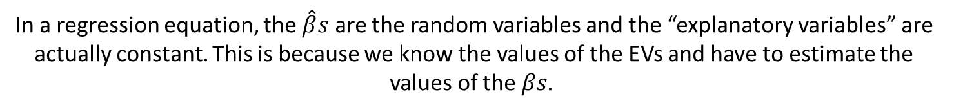

Directly Calculating Variance, SD and Confidence Intervals
Find a 95% confidence interval for the difference in the intercept between non-echolocating birds and echolocating bats (a new way!). To do this, we must first find the SE:
$$Var \left(aX+bY\right)=a2Var\left(X\right)+b2Var\left(Y\right)+2abCov(X,Y)$$
Where X and Y are random variables (not necessarily independent) and the Cov(X,Y) is simply a measure of how X and Y move together linearly.
Consider the regression equation:
$\hat{lenergy}= {\hat{β}}_{0}+{\hat{β}}_{1}lmass$ $+{\hat{β}}_{2}bird$ $+{\hat{β}}_{3}ebat$
Note: non-echolocating bat now the reference
Individual regression equations for each relevant value of TYPE:
$μ\left\{lenergy \right|lmass, TYPE=birds\}=(β_{0}+β_{2})+β_{1}lmass$: intercept = $β_{0}+β_{2}$
$μ\left\{lenergy \right|lmass, TYPE=ebat\}=(β_{0}+β_{3})+β_{1}lmass$ : intercept = $β_{0}+β_{3}$
The difference in estimate intercepts between the birds and the echolating bats:
[$({\hat{β}}_{2}+{\hat{β}}_{0})−({\hat{β}}_{0}+{\hat{β}}_{3})$]=$({\hat{β}}_{2}−{\hat{β}}_{3})$:
In a regression equation, the $\hat{β}s$ are the random variables and the “explanatory variables” are actually constant. This is because we know the values of the EVs and have to estimate the values of the $βs.$
To find the variance of the difference in estimated intercepts between the birds and the echolating bats:
$$Var \left({\hat{β}}_{2}−{\hat{β}}_{3}\right)$$
=(1)$2Var\left({\hat{β}}_{2}\right)+\left(−1\right)2Var\left({\hat{β}}_{3}\right)+2∗\left(1\right)∗\left(−1\right)∗Cov\left({\hat{β}}_{2},{\hat{β}}_{3}\right)$
=$Var\left({\hat{β}}_{2}\right)+Var\left({\hat{β}}_{3}\right)−2∗Cov\left({\hat{β}}_{2},{\hat{β}}_{3}\right)$

Slide 34





How to find the var/cov matrix in SAS?
1. Download the bat data.
2. Manipulate the data in Excel (create and code indicator variables).
(You can do this in SAS as well… instead of Excel.)
3. Make a data statement for the manipulated data in SAS.
4. Make the proc reg statement.
$\hat{lenergy}= {\hat{β}}_{0}+{\hat{β}}_{1}lmass$ $+{\hat{β}}_{2}bird$ $+{\hat{β}}_{3}ebat$
$$Var \left({\hat{β}}_{2}−{\hat{β}}_{3}\right)=Var\left({\hat{β}}_{2}\right)+Var\left({\hat{β}}_{3}\right)−2∗Cov\left({\hat{β}}_{2},{\hat{β}}_{3}\right)$$
$$Var \left({\hat{β}}_{2}−{\hat{β}}_{3}\right)=0.0130377+0.0410789−2∗0.01463932$$
Note: Cov(X,X) = Var(X)
$$Var \left({\hat{β}}_{2}−{\hat{β}}_{3}\right)=0.024838$$
Same as before!
$$St Error \left({\hat{β}}_{2}−{\hat{β}}_{3}\right)=\sqrt{0.024838}=0.1576$$

Slide 35



A. Using the Reference method in proc glm. Just think about what you would do. B. Using the Variance / Covariance Method in proc reg. (Hint: You will have had to adjust the data … use the following output below to think about how you would construct this interval.)
Find a 95% confidence interval for the difference in the intercepts between non-echolocating birds and NON-echolocating bats. (Categories of interest have changed!)
Two ways:
Make one of the types of interest a reference level.
Note: The animals have been recoded. The reference has changed.

Slide 36


A. Using the Reference method in proc glm. Find a 95% confidence interval for the difference between the intercepts for the non-echolocating bats and birds. ($β_{2}$)
$$μ\left\{lenergy\right\}= β_{0}+β_{1}lmass+β_{2}bird+β_{3}ebat$$
Ref = non-echolocating bat
df = 16 (n=20)
MOE = t_{16,.975}*SE
MOE = 2.12 * .1142
MOE = .2421
95% CI: (.10226 ± .2421)
95% CI: (-.13944, .34436)

Slide 37





B. Using the Variance / Covariance Method in proc reg. (Hint: You will have to adjust the data!)
Find a 95% confidence interval for the difference between the intercepts for the non-echolocating bats and birds.
$$μ\left\{lenergy\right\}= β_{0}+β_{1}lmass+β_{2}bird+β_{3}nebat$$
Ref = echolocating bat
$$Var \left({\hat{β}}_{2}−{\hat{β}}_{3}\right)=Var\left({\hat{β}}_{2}\right)+Var\left({\hat{β}}_{3}\right)−2Cov({\hat{β}}_{2},{\hat{β}}_{3})$$
$$Var \left({\hat{β}}_{2}−{\hat{β}}_{3}\right)=.02484+.04108−2(.02644)$$
$$Var \left({\hat{β}}_{2}−{\hat{β}}_{3}\right)= .01304$$
${\hat{β}}_{2}−$ ${\hat{β}}_{3}= .02360 − \left(−.07866\right)= .10266$
SE$\left({\hat{β}}_{2}−{\hat{β}}_{3}\right)= \sqrt{.01304}=.1142$
df = 16 (n=20)
MOE = t_{16,.975}*SE
MOE=2.12* .1142
MOE = .2421
95% CI: (.10226 ± .2421)
95% CI: (-.13944, .34436)
Same as before!

Slide 38




Another Example: Metabolism Study Variance / Covariance Method
Find a 95% confidence interval for the expected log lifespan of the Echidna given its log metabolism and its log mass.
$$μ\left\{\log\left(life\right)\right\}=β_{0}+β_{1}log⁡(metab)+β_{2}log⁡(mass)$$
$$μ\left\{\log\left(life\right)\right\}=3.7193−0.3161\log\left(metab\right)+0.5346 log⁡(mass)$$
$$μ\left\{\log\left(life\right)|logmass=.91629, logmetab=5.7104\right\}$$
$$=3.7193−0.3161∗5.7104+0.5346∗0.91629$$
$μ\left\{\log\left(life\right)|logmass=.91629, logmetab=5.7104\right\}$=2.404
Point estimate (center) for confidence interval
$$Var(\text{μ}\text{\{}\text{log}\text{(}\text{life}\text{) |}\text{logmass}\text{=.91629, }\text{logmetab}\text{=5.7104\}})$$
$$=Var({\hat{β}}_{0}+5.7104{\hat{β}}_{1}+.91629{\hat{β}}_{2})$$

Slide 39






Find a 95% confidence interval for the expected log lifespan of the Echidna given its log metabolism and its log mass.
$$Var\left(β_{0}+{aβ}_{1}+{bβ}_{2}\right)=$$
$$Var\left({\hat{β}}_{0}\right)+a^{2}Var\left({\hat{β}}_{1}\right)+b^{2}Var\left({\hat{β}}_{2}\right)+ 2aCov\left({\hat{β}}_{0},{\hat{β}}_{1}\right)+2bCov\left({\hat{β}}_{0},{\hat{β}}_{2}\right)+2abCov\left({\hat{β}}_{1},{\hat{β}}_{2}\right)$$
$$Var(\text{μ}\text{\{}\text{log}\text{(}\text{life}\text{) |}\text{logmass}\text{=.91629, }\text{logmetab}\text{=5.7104\})}$$
$$=Var({\hat{β}}_{0}+5.7104{\hat{β}}_{1}+.91629{\hat{β}}_{2})$$
$$μ\left\{\log\left(life\right)\right\}=β_{0}+β_{1}log⁡(metab)+β_{2}log⁡(mass)$$
$$Var(\text{μ}\text{\{}\text{log}\text{(}\text{life}\text{) |}\text{logmass}\text{=.91629, }\text{logmetab}\text{=5.7104\})}={.2343+\left(5.7104\right)}^{2}(.0073){+ \left(.91629\right)}^{2}\left(.0041\right)$$
$$+2\left(5.7104\right)\left(−.04129\right)+2\left(.91629\right)\left(.03046\right)+2\left(5.7104\right)(.91629)(−.00541)$$
$$Var\left(\text{μ}\text{\{}\text{log}\text{(}\text{life}\text{) |}\text{logmass}\text{=.91629, }\text{logmetab}\text{=5.7104\}}\right)=.004236$$
$$→SE\left(\text{μ}\text{\{}\text{log}\text{(}\text{life}\text{) |}\text{logmass}\text{=.91629, }\text{logmetab}\text{=5.7104\}}\right)= \sqrt{.0042}=.06509$$
df = 92 (n=95)
MOE = t_{92,.975} * $SE$
MOE = 1.986 * .06509
MOE = 0.129
95% CI: (2.404 ± 0.129)
95% CI: (2.275, 2.533)
Remember this!
Remember this!

Slide 40


Find a 95% confidence interval for the expected log lifespan of the Echidna given its log metabolism and its log mass.
Example: Metabolism Study Re-centering method
Want a 95% CI for$\text{μ}\text{\{}\text{log}\text{(}\text{life}\text{) |}\text{logmass}\text{=.91629, }\text{logmetab}\text{=5.7104\}}$.
Create new variables so that the values of independent variables of interest will equal 0.
When logmass = .91629, nlogmass = logmass - .91629=.91629-.91629=0
When logmetab = 5.7104, nlogmetab = logmetab – 5.7104=5.7104-5.7104=0
So, $\text{μ}\text{\{}\text{log}\text{(}\text{life}\text{) |}\text{logmass}\text{=.91629, }\text{logmetab}\text{=5.7104\}=}\text{μ}\text{\{}\text{log}\text{(}\text{life}\text{) |}\text{n}\text{logmass}\text{=0, }\text{n}\text{logmetab}\text{=0\}}$
$$\text{μ}\text{\{}\text{log}\text{(}\text{life}\text{) |}\text{n}\text{logmass}\text{, }\text{n}\text{logmetab}\text{\}}={β′}_{0}+{β′}_{1}nlogmetab+{β′}_{2}nlogmass$$
$$\text{μ}\text{\{}\text{log}\text{(}\text{life}\text{) |}\text{n}\text{logmass}\text{=0}\text{, }\text{n}\text{logmetab}\text{=0}\text{\}}={β′}_{0}+{β′}_{1}∗0+{β^{′}}_{2}∗0={β′}_{0}$$
A 95% CI for$\text{μ}\text{\{}\text{log}\text{(}\text{life}\text{) |}\text{n}\text{logmass}\text{=0, }\text{n}\text{logmetab}\text{=0\}}$= a 95% CI for ${β′}_{0}$.
df = 92 (n=95)
MOE = t_{92,.975} * SE
MOE = 1.986 * .06509
MOE = 0.129
95% CI: (2.404 ± 0.129)
95% CI: (2.275, 2.533)

Slide 41
Example: Metabolism Study Re-centering method
$$\text{μ}\text{\{}\text{log}\text{(}\text{life}\text{)\}}=β_{0}+β_{1}log⁡(metab)+β_{2}log⁡(mass)$$
n = 95
When logmass = .91629 and logmetab = 5.7104, the expected mean log(life) is 2.404 and a 95% CI is (2.275, 2.533). On the original scale, for a mammal with a mass of 2.5 kg and a metabolism of 302 units, the expected median lifespan is e^{2.404} =11.07 years. A 95% CI for the median lifespan for a mammal with these attributes is (e^{2.275},e^{2.533}) = (9.73, 12.59) years.

Slide 42
Appendix

Slide 43


Variance formula

